Slide 1
Securing Your Docker Image Registry for Production
Jason Heiss

Slide 2
Image Registry
A place to store your container images
Private version of hub.docker.com

Slide 3
Image Registry Security
Why do we need registry security?
Malicious changes
Inadvertent changes
Developer pushes to production image
Production team A pushes to Production team B image
Naming standards
hub.example.com/databese:1.0
hub.example.com/my_quick_hack:0.1

Slide 4
AAA
Authentication
Authorization
Audit Logging

Slide 5
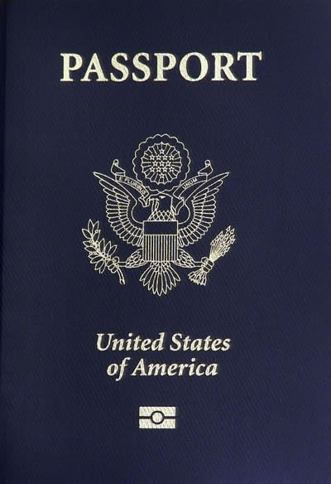
Authentication
Who is the user?
Photograph by Robert Rexach

Slide 6
Why Authentication?
Hard to do authorization without authentication
Makes audit logs more useful
Image X pushed Oct 31, 2016
Image X pushed by Jane Doe Oct 31, 2016

Slide 7
Authentication Choices
Lots of choices
Password
SSL cert
Kerberos
Fingerprint
Physical token
Many organizations often have unusual or custom authentication needs

Slide 8
Image Registry Choices
Docker Registry (open source)
Docker Trusted Registry
CoreOS Quay Enterprise
JFrog Artifactory
Notable for allowing you to front it with Apache httpd or nginx for authentication
You can use any authentication scheme supported by httpd or nginx

Slide 9
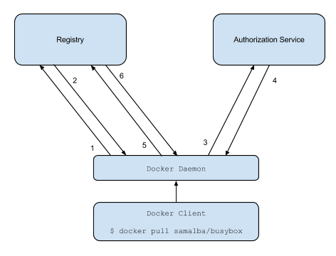
Docker Registry
Registry redirects daemon to auth service
Daemon authenticates to auth service with password or OAuth2 token, gets a bearer token
Daemon uses bearer token to authenticate to registry
Registry trusts bearer tokens from auth service based on public/private key pair that you configure
Image from https://docs.docker.com/registry/spec/auth/token/

Slide 10
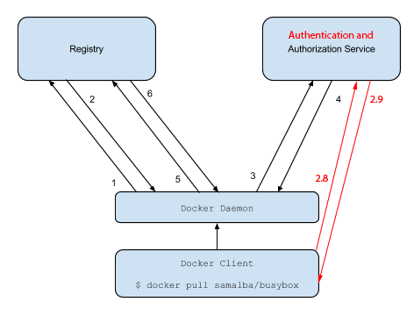
Docker Registry
Registry redirects daemon to auth service
Daemon authenticates to auth service with password or OAuth2 token, gets a bearer token
Daemon uses bearer token to authenticate to registry
Registry trusts bearer tokens from auth service based on public/private key pair that you configure
Image from https://docs.docker.com/registry/spec/auth/token/

Slide 11
Auth Service Choices
https://github.com/docker/distribution/tree/master/contrib/token-server
https://github.com/cesanta/docker_auth
https://github.com/opendns/registry-oauth-server
https://github.com/SUSE/Portus
GitLab Container Registry

Slide 12
Authentication Demo
Demonstrate authentication with Docker Registry, Docker Engine (Client/Daemon), and https://github.com/opendns/registry-oauth-server

Slide 13
Docker Client and Registry Authentication
Docker daemon asks Docker client for username, password to authenticate to registry auth server
https://docs.docker.com/engine/reference/commandline/login/
docker login
Password stored, unencrypted, in $HOME/.docker/config.json
Credentials store
Configured in config.json: {"credsStore": “mycredstore"}
Docker runs docker-credential-mycredstore
Must be in your PATH
Can be abused to fetch a password on the fly

Slide 14
Credentials Store Demo
Demonstrate using a credentials store to fetch a password

Slide 15

Authorization
What is the user allowed to do?
Photograph by Tony Webster

Slide 16
Docker Registry
Image from https://docs.docker.com/registry/spec/auth/token/

Slide 17
Docker Registry Authorization
Redirect from registry to auth service includes info about requested operation:
Actions: push, pull, *
Auth server lists allowed actions in the token it returns
WWW-Authenticate: Bearer
realm="https://auth.example.com/token",
service="registry.example.com",
scope="repository:samalba/my-app:pull,push"

Slide 18
Authorization Demo
Demonstrate allowing or blocking actions based on the scope parameter sent to the auth server

Slide 19
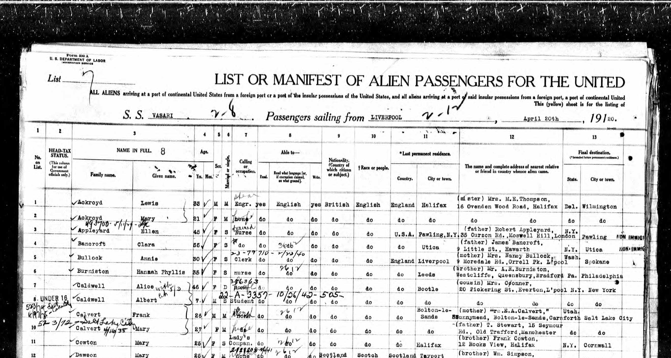
Audit Logging
What happened in the past?
Photograph by U.S. Department of Labor

Slide 20
Why Audit Logging?
Who pushed the last change to image A?
When was image B last changed?

Slide 21
Docker Registry Audit Logging
Registry server logs: docker logs registry
Registry notifications
https://docs.docker.com/registry/notifications/
Webhook notifications to external service
Registry sends JSON blob of details
You can extract the interesting bits and save them

Slide 22
Audit Logging Demo
Demonstrate configuring the registry to send notifications to our server

Slide 23
Kubernetes and Registry Authentication
http://kubernetes.io/docs/user-guide/images/
kubelet acts as Docker client for pulling images
So, same choices as previously mentioned for the Docker client:
docker login, password in /root/.docker/config.json
credential manager, configured in config.json
Or user can provide their own image registry “password” as image pull secret in their pod manifest
kubelet creates a one-off config.json in this case

Slide 24
The End
Me:
@jason_heiss
This talk: slides and demo code
https://github.com/twosigma/docker-repo-auth-demo
Work:
Two Sigma Investments
https://www.twosigma.com/
We’re hiring!

